Slide 1
Lesson 4 – Homework review

Slide 2

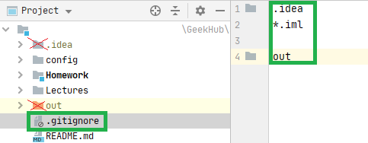
Do not track developer-specific files

Slide 3

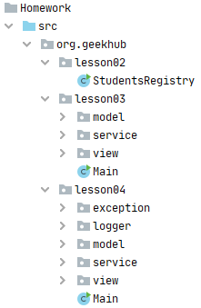
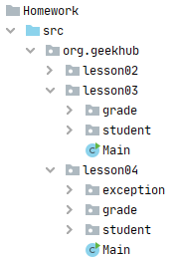
Do not Repeat Yourself

Slide 4
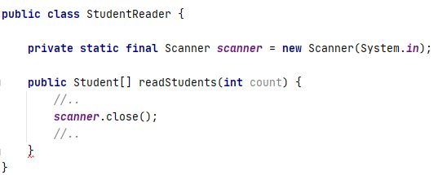
Apply ARM

Slide 5
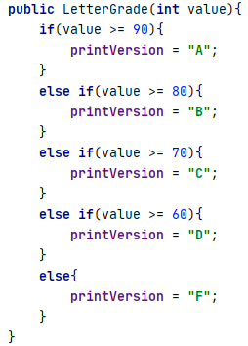
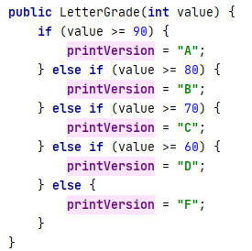
Follow format convention

Slide 6
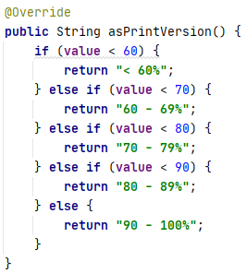
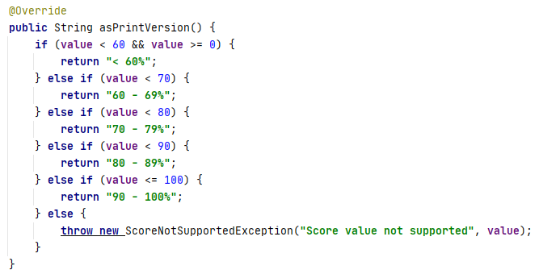
Handle edge cases

Slide 7
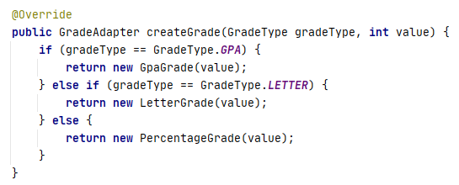
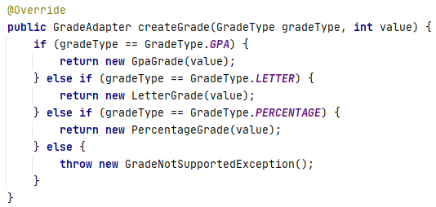
Handle edge cases

Slide 8

Incorrect termination reason

Slide 9



Do not use toString for business logic

Slide 10


Useless exception usage

Slide 11


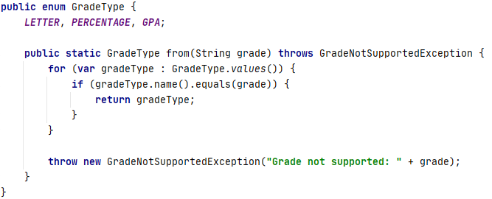
Follow atomic security

Slide 12

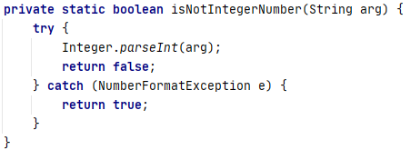

Write optimal code

Slide 13



Do not jump the gun

